Slide 1


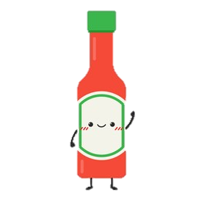
SourcE-commerce
HOT!
Presented to you by TEAM Awesome-Sauce
e-Commerce
(Hoisin Sauce) | (Hollandaise Sauce) | (BBQ Sauce) | (Tamacco Sauce)
Jessie Ng | Fraser Clarke | Mushtaq Safie | Fatima Fakih

Slide 2
“It’s one small step for the internet, one giant leap for e-commerce.”
Elevator Pitch

Slide 3

Concept
DESCRIPTION
An inventory & sales tracker for businesses, coupled with a simple, clean storefront for customers!
USER STORY (two-fold)
AS A Business Owner… I want to be able to track my inventory & sales performance so that I can better manage different aspects of my business based on items ordered in my ‘storefront’.
AS AN Online Shopper… I want to be able to see product information (ie name & price) so that I can shop for items I want.
MOTIVATION FOR DEVELOPMENT
With e-commerce growing in popularity, especially in the wake of Covid, it is now more important than ever for businesses to be able to accurately track their business performance and inventory when customers shop their products.
Customers get a user-friendly e-Storefront and businesses get an intuitive application by having both elements within the same platform.

Slide 4
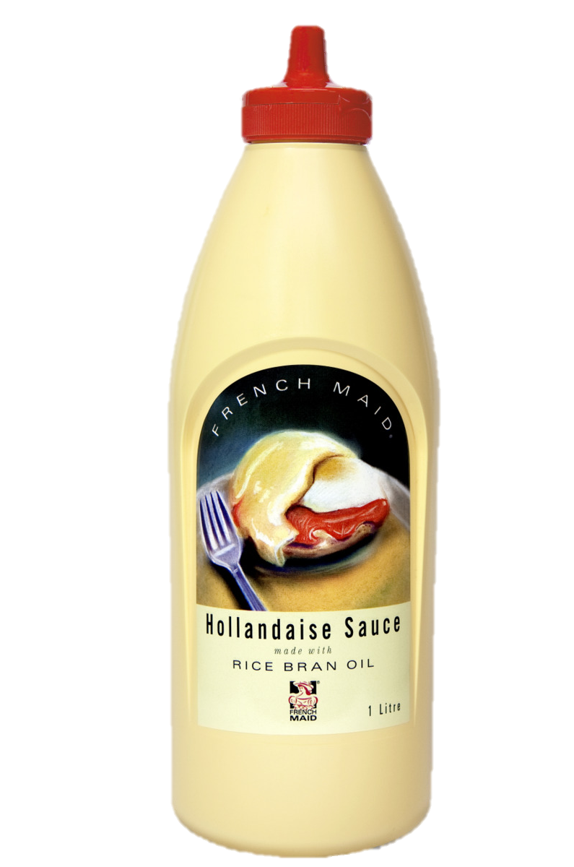

Process
Technologies Used:
HTML, CSS, JavaScript
Bootstrap CSS, GoogleFonts, FontAwesome
GitBash
Node Environment
Express.js Framework
MySQL Database
Sequelize ORM
Handlebars.js
Heroku Platform
Highcharts library
Challenges:
Travis
Authentication
Get / Post Requests
Traversing Handlebars DOM
Successes:
Handlebars implementation
Integration between pages despite different client types
Highcharts
Breakdown of tasks & roles:
JESSIE (Front-end)…
Project Manager, Repo Setup & Folder Structure
Wireframe, README & Presentation
HTML via handlebars, CSS & JavaScript w/Highcharts
FRASER (Front-end)…
HTML via handlebars & JavaScript
MUSHTAQ (Back-end)…
MySQL Database w/Sequelize
API Requests & Routes
FATIMA (Back-end & Front-end support)…
Login & Create authentication
Front-end support

Slide 5


DEMO
**Insert Wireframes**
Have a look at our Heroku-deployed application HERE!

Slide 6

Directions for Future Development
Add a User Account Management Page to allow users to update personal details
Add exportable Customer CRM (db) for Business Owners: Sales Data & Inventory List
Update Inventory on Business side as Customer places new order of selected items
Implement search capability for both Customers & Businesses to locate a specific product
Incorporate table of sales data on dashboard page below line graph (ie product, category, qty, sales total, amount sold, etc)
Allow user to add user photo at account creation & have it displayed on sidebar
Add log out & user photo functionality
Allow Businesses to have multiple storefronts

Slide 7


Links
Heroku Deployed Application
https://sourc3-commerce.herokuapp.com/
GitHub Repository
https://github.com/MissNG-Git/SourcE-commerce
HOT!
e-Commerce

